Slide 1

UNIT - IV
Clustering: Average Linkage - BIRCH - CURE - Expectation-Maximization, Ward’s Algorithm - Minimum Spanning Tree Clustering - DBSCAN - Evaluation of clustering. Outlier Analysis: Introduction - Extreme Value Analysis - Probabilistic Models Clustering for Outlier Detection – Distance Based Outlier Detection - Density-Based Methods
How the Hierarchical Clustering Algorithm Works

Slide 2
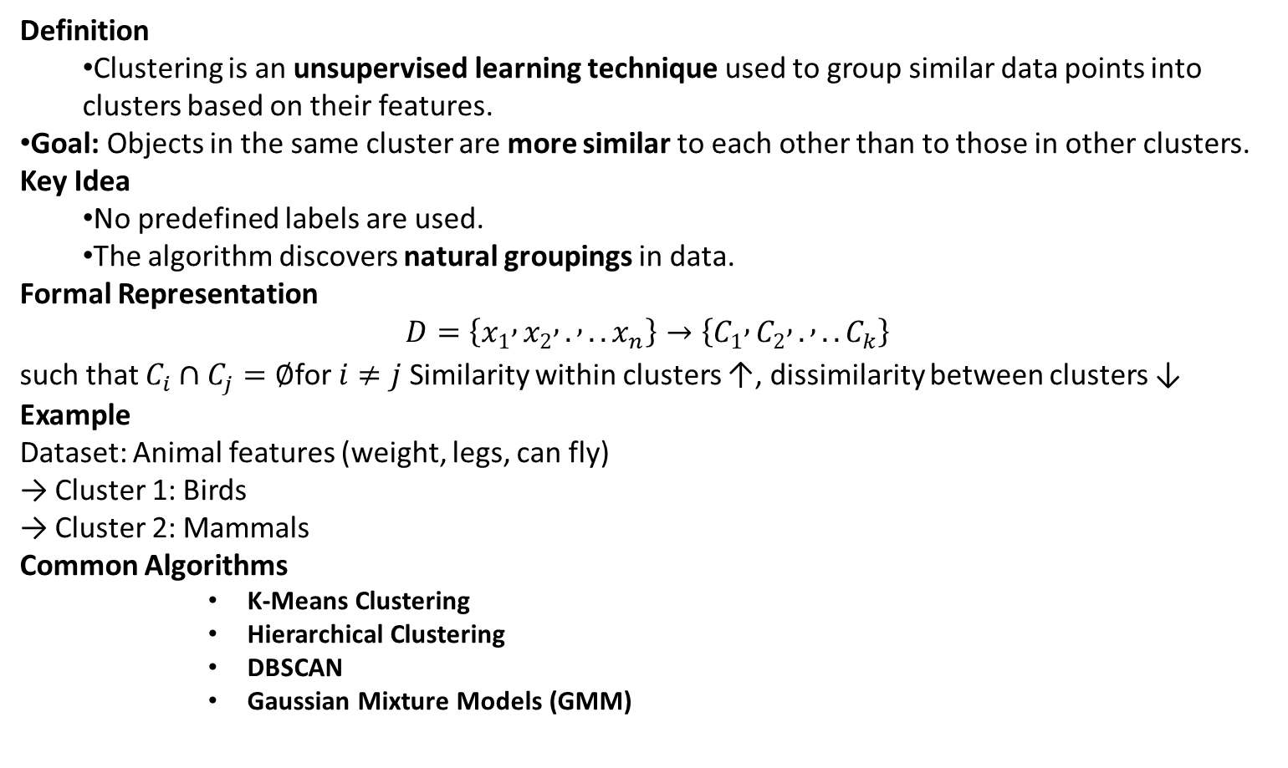
Clustering
Definition
Clustering is an unsupervised learning technique used to group similar data points into clusters based on their features.
Goal: Objects in the same cluster are more similar to each other than to those in other clusters.
Key Idea
No predefined labels are used.
The algorithm discovers natural groupings in data.
Formal Representation
$$D=\left\{x_{1} , x_{2} , . , ..x_{n}\right\}→\left\{C_{1} , C_{2} , . , ..C_{k}\right\}$$
such that $C_{i}∩C_{j}=∅$for $i≠j$ Similarity within clusters ↑, dissimilarity between clusters ↓
Example
Dataset: Animal features (weight, legs, can fly) → Cluster 1: Birds → Cluster 2: Mammals
Common Algorithms
K-Means Clustering
Hierarchical Clustering
DBSCAN
Gaussian Mixture Models (GMM)

Slide 3
Distance Measures in Algorithmic Methods
Hierarchical Agglomerative Clustering
What is Hierarchical Agglomerative Clustering (HAC)?
It is a bottom-up clustering method where:
Each data point starts as its own cluster, and
Pairs of clusters are merged step-by-step based on a distance (similarity) measure, until all points belong to a single cluster or a stopping criterion is met.
The result is represented as a dendrogram, a tree-like diagram showing the hierarchy of merges.

Slide 4
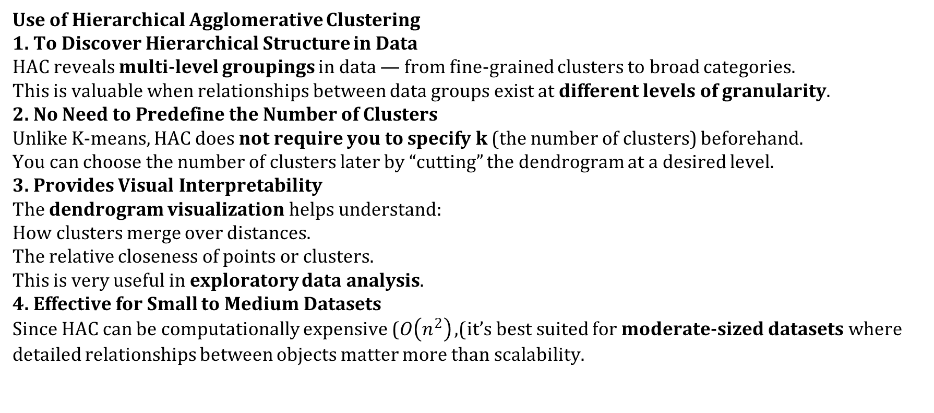
Use of Hierarchical Agglomerative Clustering
1. To Discover Hierarchical Structure in Data
HAC reveals multi-level groupings in data — from fine-grained clusters to broad categories. This is valuable when relationships between data groups exist at different levels of granularity.
2. No Need to Predefine the Number of Clusters
Unlike K-means, HAC does not require you to specify k (the number of clusters) beforehand. You can choose the number of clusters later by “cutting” the dendrogram at a desired level.
3. Provides Visual Interpretability
The dendrogram visualization helps understand:
How clusters merge over distances.
The relative closeness of points or clusters. This is very useful in exploratory data analysis.
4. Effective for Small to Medium Datasets
Since HAC can be computationally expensive ($O\left(n^{2}\right)$), it’s best suited for moderate-sized datasets where detailed relationships between objects matter more than scalability.

Slide 5
5. Versatile Similarity Measures
You can choose various linkage criteria:
Single linkage: minimum distance (good for chain-like clusters)
Complete linkage: maximum distance (compact clusters)
Average linkage: mean distance (balanced)
Ward’s method: minimizes variance (spherical clusters)
This flexibility allows HAC to adapt to different data geometries and clustering goals.
6. Used for Domain-Specific Grouping Tasks
HAC is frequently used in:
Bioinformatics: building phylogenetic trees (evolutionary hierarchies)
Text mining: grouping similar documents
Image segmentation: merging pixels or regions by similarity
Market segmentation: discovering consumer preference hierarchies
Gene expression analysis: identifying gene function similarities

Slide 6
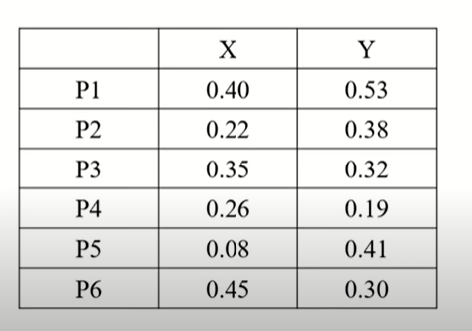
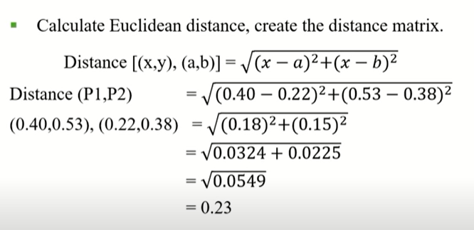
Example
Hierarchical Agglomerative Clustering [HAC - Complete Link]

Slide 7
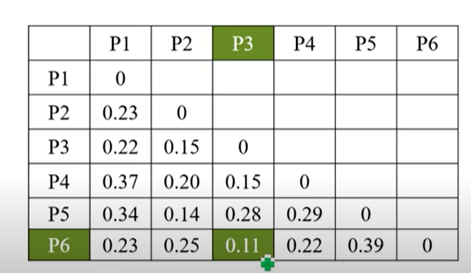
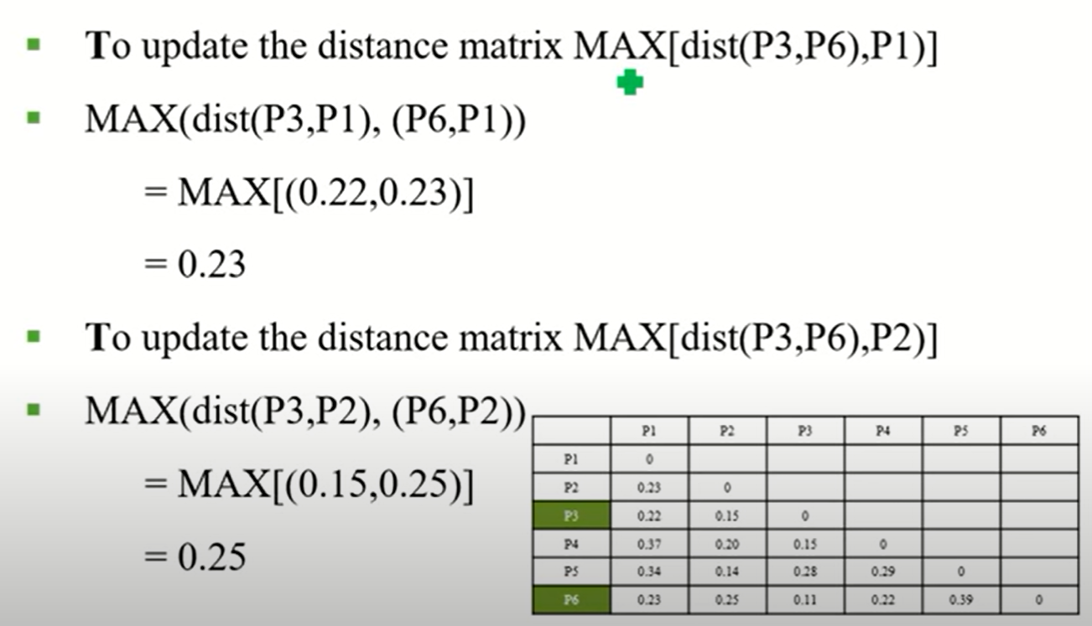
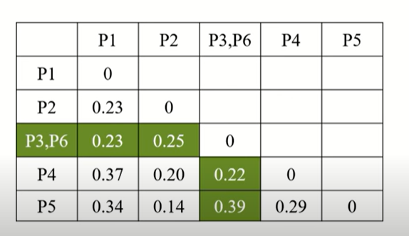
Distance Measures in Algorithmic Methods
Hierarchical Agglomerative Clustering [HAC - Complete Link]

Slide 8
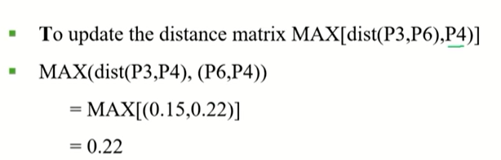
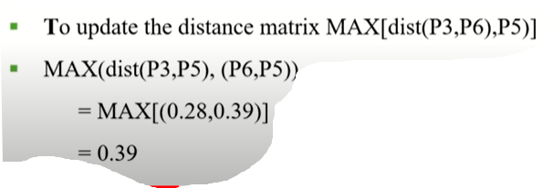
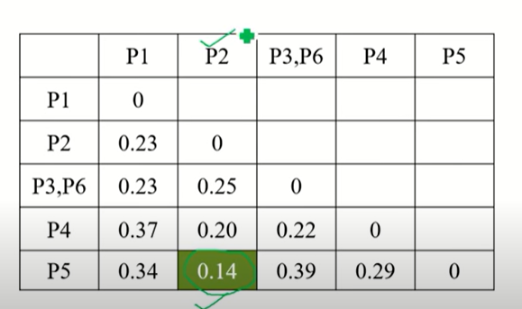
Distance Measures in Algorithmic Methods
Hierarchical Agglomerative Clustering [HAC - Complete Link]

Slide 9
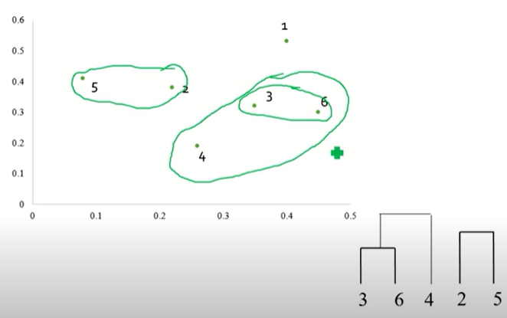
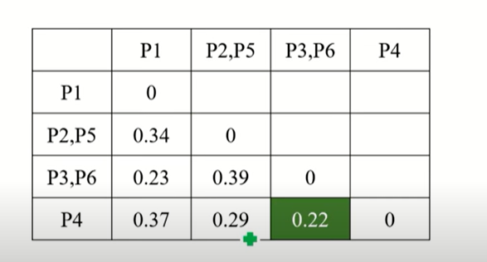
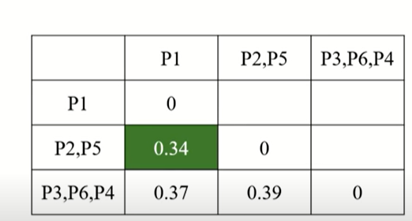
Distance Measures in Algorithmic Methods
Hierarchical Agglomerative Clustering [HAC - Complete Link]

Slide 10
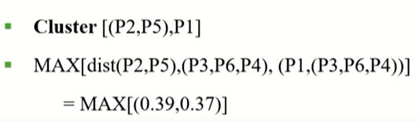
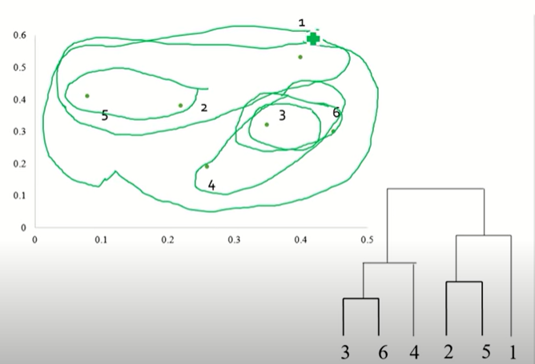
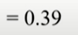
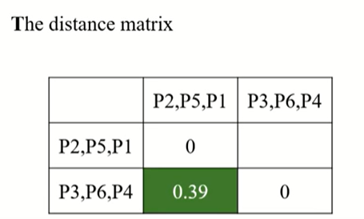
Distance Measures in Algorithmic Methods
Hierarchical Agglomerative Clustering [HAC - Complete Link]

Slide 11
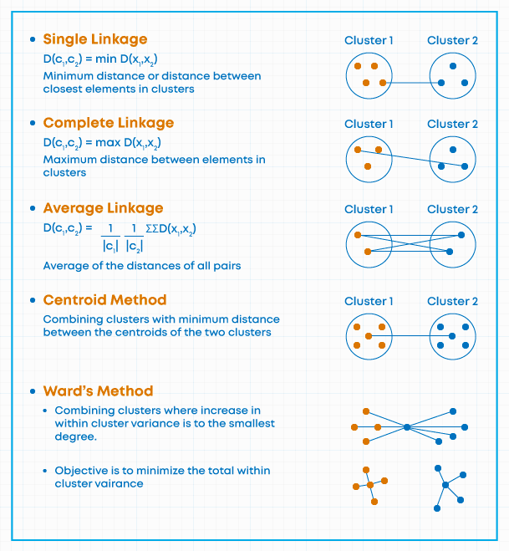

Slide 12
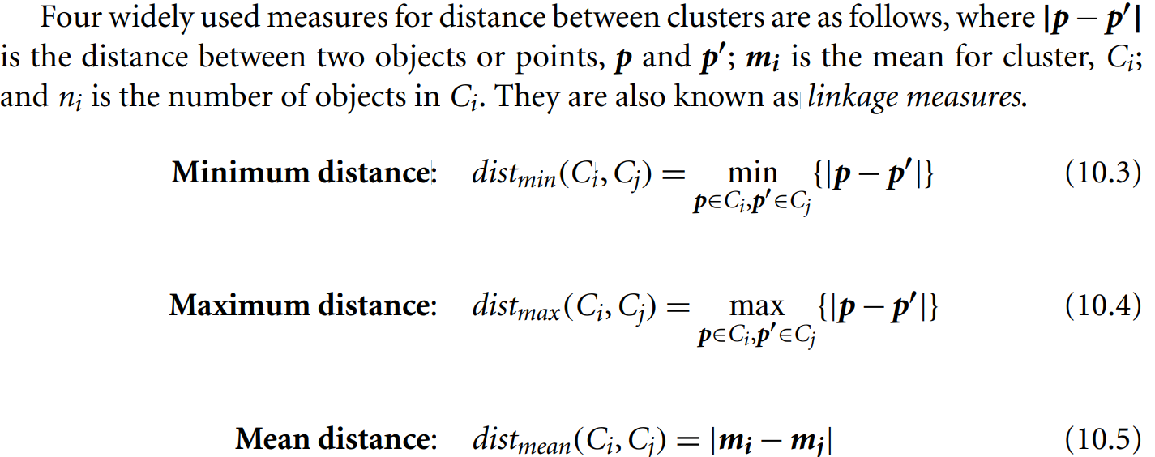
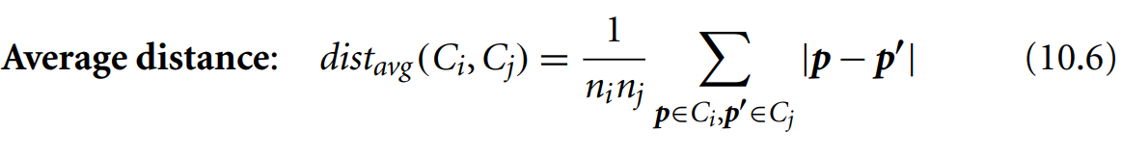
Distance Measures in Algorithmic Methods

Slide 13
Distance Measures in Algorithmic Methods
When an algorithm uses the minimum distance, d_{min}(C_{i} ,C_{j}), to measure the distance between clusters, it is sometimes called a nearest-neighbor clustering algorithm.
Moreover, if the clustering process is terminated when the distance between nearest clusters exceeds a user-defined threshold, it is called a single-linkage algorithm.

Slide 14
Distance Measures in Algorithmic Methods
If we view the data points as nodes of a graph, with edges forming a path between the nodes in a cluster, then the merging of two clusters, C_{i} and C_{j} , corresponds to adding an edge between the nearest pair of nodes in C_{i} and C_{j} .
Because edges linking clusters always go between distinct clusters, the resulting graph will generate a tree.
Thus, an agglomerative hierarchical clustering algorithm that uses the minimum distance measure is also called a minimal spanning tree algorithm, where a spanning tree of a graph is a tree that connects all vertices, and a minimal spanning tree is the one with the least sum of edge weights.

Slide 15
Distance Measures in Algorithmic Methods
When an algorithm uses the maximum distance, d_{max}(C_{i} ,C_{j}), to measure the distance between clusters, it is sometimes called a farthest-neighbor clustering algorithm.
If the clustering process is terminated when the maximum distance between nearest clusters exceeds a user-defined threshold, it is called a complete-linkage algorithm.
By viewing data points as nodes of a graph, with edges linking nodes, we can think of each cluster as a complete subgraph, that is, with edges connecting all the nodes in the clusters.

Slide 16
BIRCH: Multiphase Hierarchical Clustering Using Clustering Feature Trees
Balanced Iterative Reducing and Clustering using Hierarchies (BIRCH) is designed for clustering a large amount of numeric data by integrating hierarchical clustering (at the initial microclustering stage) and other clustering methods such as iterative partitioning (at the later macroclustering stage).
It overcomes the two difficulties in agglomerative clustering methods:
(1) scalability and
(2) the inability to undo what was done in the previous step.

Slide 17
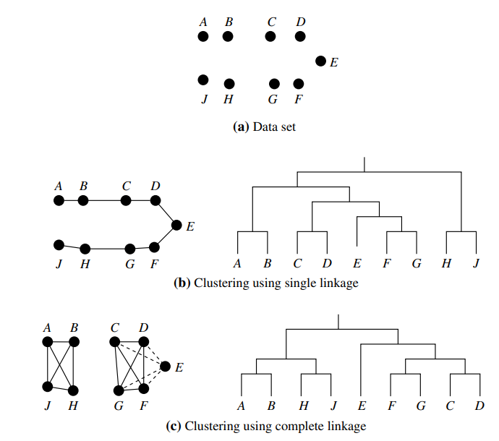
BIRCH: Multiphase Hierarchical Clustering Using Clustering Feature Trees
BIRCH uses the notions of clustering feature to summarize a cluster, and clustering feature tree (CF-tree) to represent a cluster hierarchy.
These structures help the clustering method achieve good speed and scalability in large or even streaming databases, and also make it effective for incremental and dynamic clustering of incoming objects.
Figure 10.8 Hierarchical clustering using single and complete linkages.

Slide 18
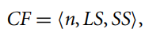
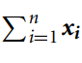
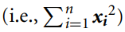
BIRCH: Multiphase Hierarchical Clustering Using Clustering Feature Trees
Consider a cluster of n d-dimensional data objects or points.
The clustering feature (CF) of the cluster is a 3-D vector summarizing information about clusters of objects.
It is defined as where LS is the linear sum of the n points
(i.e., and SS is the square sum of the data points
A clustering feature is essentially a summary of the statistics for the given cluster.
Using a clustering feature, we can easily derive many useful statistics of a cluster.
For example, the cluster’s centroid, x₀, radius, R, and diameter, D, are

Slide 19
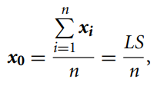
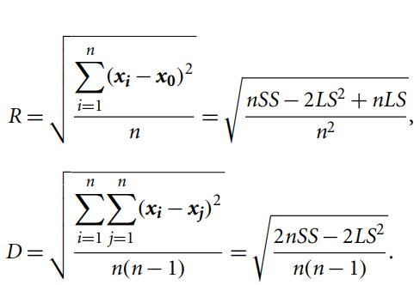
BIRCH: Multiphase Hierarchical Clustering Using Clustering Feature Trees
Here, R is the average distance from member objects to the centroid, and D is the average pairwise distance within a cluster.
Both R and D reflect the tightness of the cluster around the centroid.
Summarizing a cluster using the clustering feature can avoid storing the detailed information about individual objects or points.
Instead, we only need a constant size of space to store the clustering feature.
This is the key to BIRCH efficiency in space & Moreover, clustering features are additive.

Slide 20
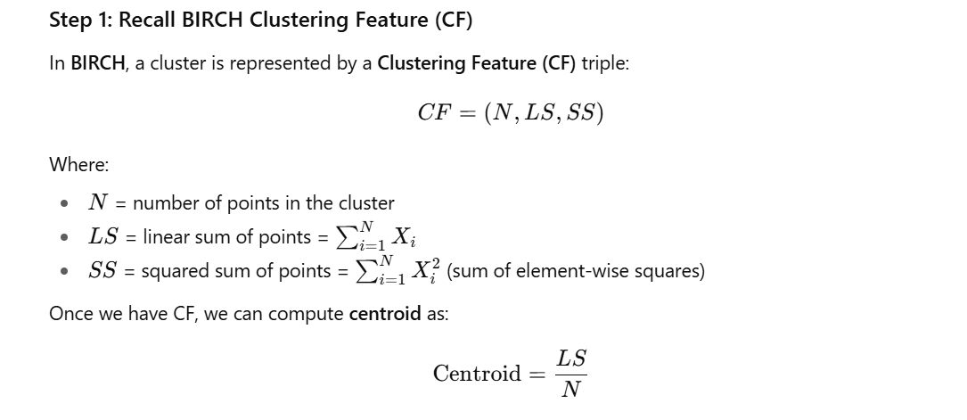
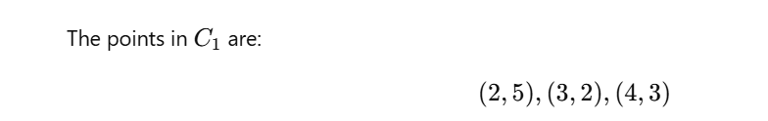

Slide 21
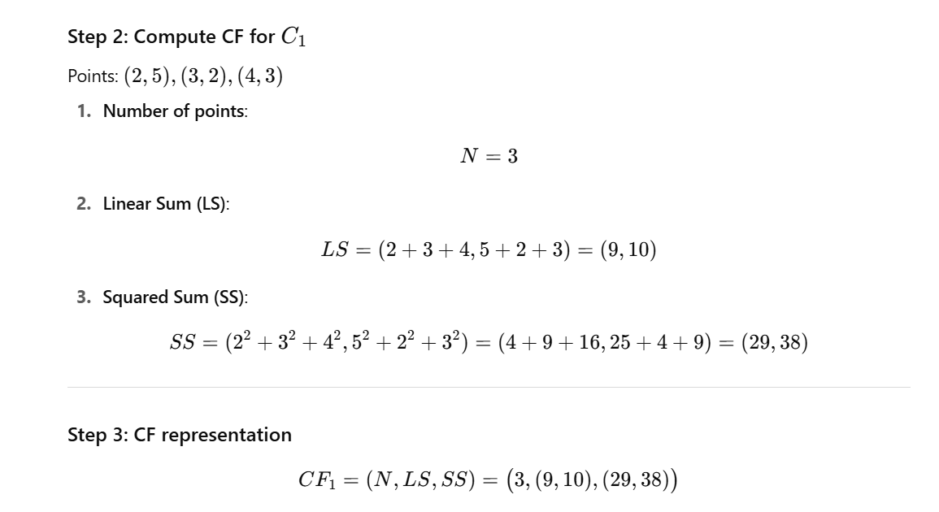

Slide 22
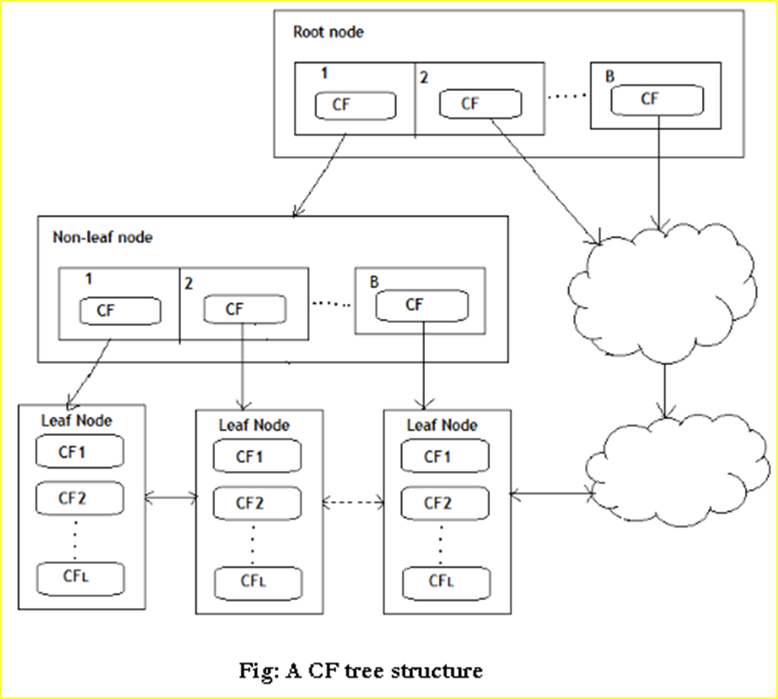
BIRCH: Multiphase Hierarchical Clustering Using Clustering Feature Trees
A CF-tree is a height-balanced tree that stores the clustering features for a hierarchical clustering.
An example is shown in Figure .

Slide 23
BIRCH: Multiphase Hierarchical Clustering Using Clustering Feature Trees
By definition, a nonleaf node in a tree has descendants or “children.”
The nonleaf nodes store sums of the CFs of their children, and thus summarize clustering information about their children.
A CF-tree has two parameters: branching factor, B, and threshold, T.
The branching factor specifies the maximum number of children per nonleaf node.
The threshold parameter specifies the maximum diameter of subclusters stored at the leaf nodes of the tree.
These two parameters implicitly control the resulting tree’s size.

Slide 24
BIRCH: Multiphase Hierarchical Clustering Using Clustering Feature Trees
Given a limited amount of main memory, an important consideration in BIRCH is to minimize the time required for input/output (I/O).
BIRCH applies a multiphase clustering technique:
A single scan of the data set yields a basic, good clustering, and one or more additional scans can optionally be used to further improve the quality.
The primary phases are
Phase 1: BIRCH scans the database to build an initial in-memory CF-tree, which can be viewed as a multilevel compression of the data that tries to preserve the data’s inherent clustering structure.
Phase 2: BIRCH applies a (selected) clustering algorithm to cluster the leaf nodes of the CF-tree, which removes sparse clusters as outliers and groups dense clusters into larger ones.

Slide 25
BIRCH: Multiphase Hierarchical Clustering Using Clustering Feature Trees
“How effective is BIRCH?”
The time complexity of the algorithm is O(n), where n is the number of objects to be clustered.
Experiments have shown the linear scalability of the algorithm with respect to the number of objects, and good quality of clustering of the data.
Each node in a CF-tree can hold only a limited number of entries due to its size.

Slide 26
BIRCH: Multiphase Hierarchical Clustering Using Clustering Feature Trees
If the clusters are not spherical in shape,
BIRCH does not perform well because it uses the notion of radius or diameter to control the boundary of a cluster.

Slide 27
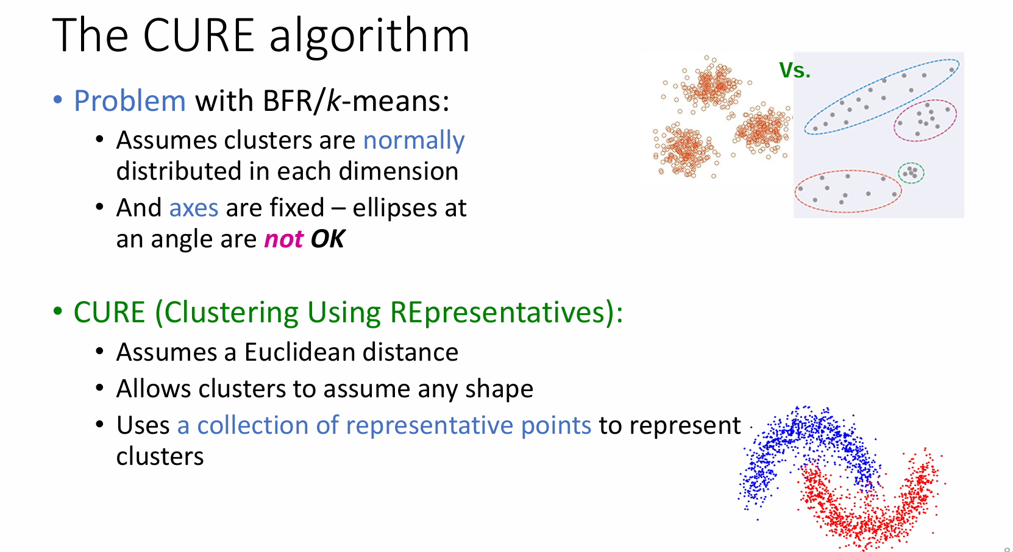
CURE-(Clustering Using Representatives)

Slide 28
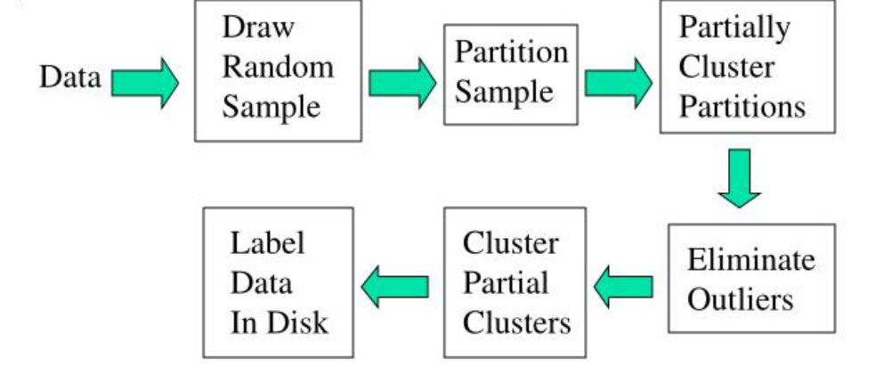
CURE-(Clustering Using Representatives)

Slide 29
Algorithm
Pass 1
Pick random samples that fit in main memory and cluster them.
Choose c scattered points in each cluster. (Let’s take c = 4.)
These scattered points are shrunk towards the centroid by a fraction α, where 0 < α < 1.
Use dmin cluster merging approach, considering these scattered points as representatives of clusters.
Pass 2
After every merge, new points merged are considered as representatives for the new cluster.
Finally, cluster merging will stop when the target k (number of clusters) is achieved.

Slide 30
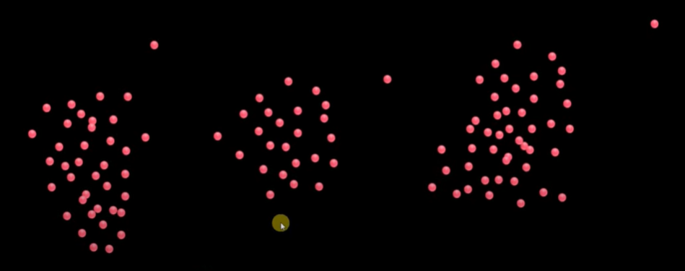
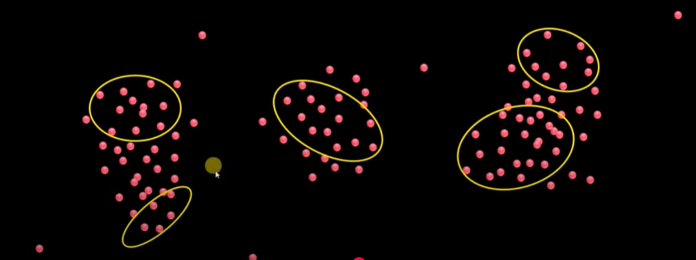
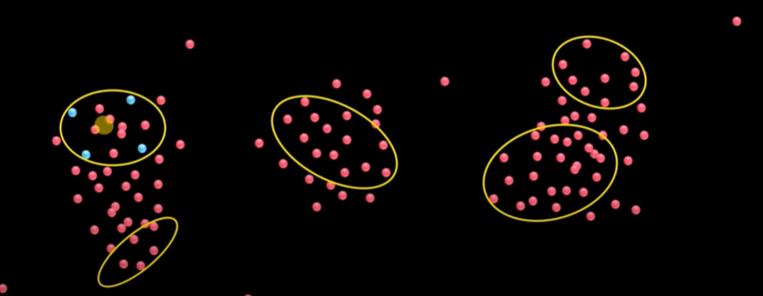
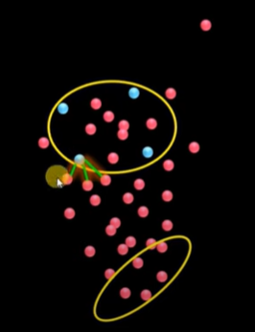
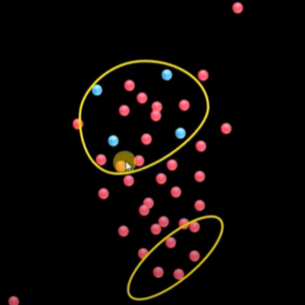
EXAMPLE
Initial data points
Pick random samples that fit in main memory and cluster them.
Choose c scattered points in each cluster. (Let’s take c = 4.)
Use dmin cluster merging approach, considering these scattered points as representatives of clusters.

Slide 31
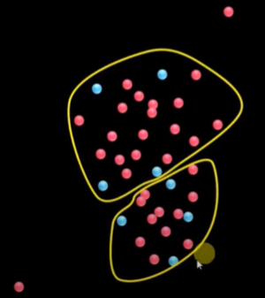
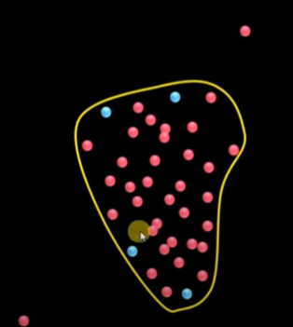
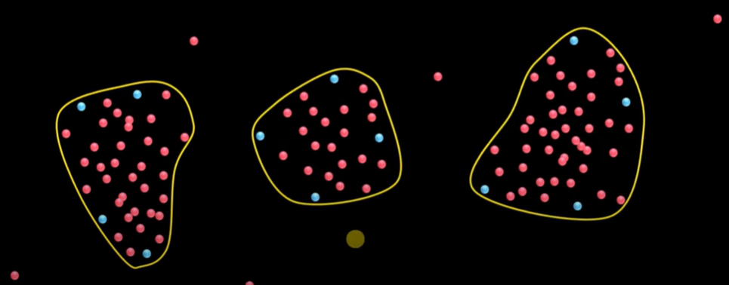
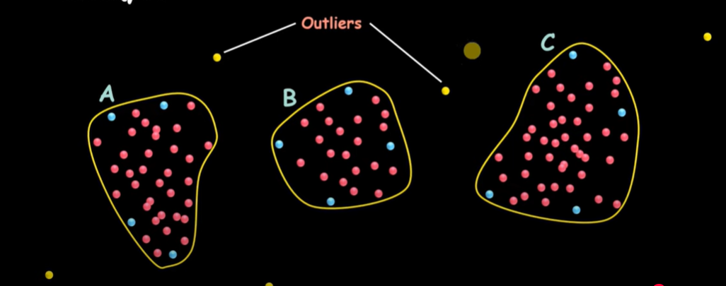
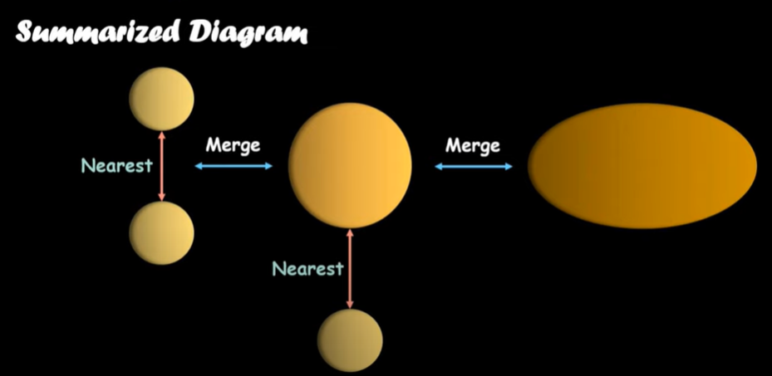

Slide 32
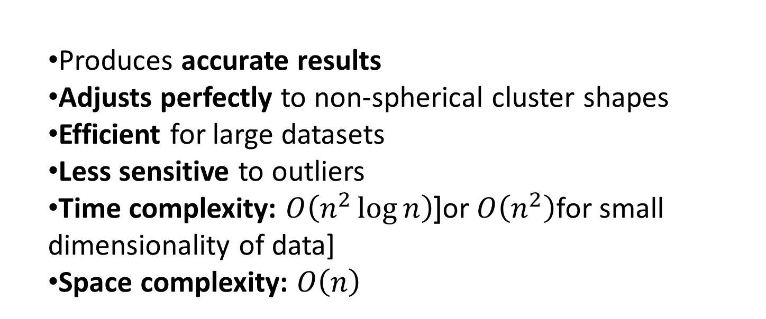
Advantages of CURE Algorithm
Produces accurate results
Adjusts perfectly to non-spherical cluster shapes
Efficient for large datasets
Less sensitive to outliers
Time complexity: $O\left(n^{2}\log{n}\right)$[or $O\left(n^{2}\right)$for small dimensionality of data]
Space complexity: $O\left(n\right)$

Slide 33
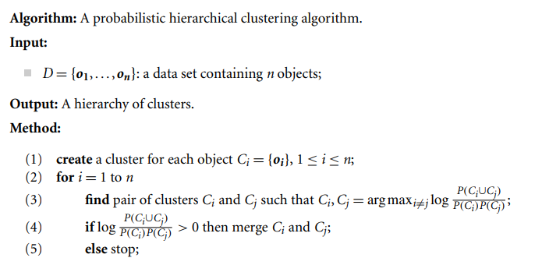
10.3.5 Probabilistic Hierarchical Clustering

Slide 34
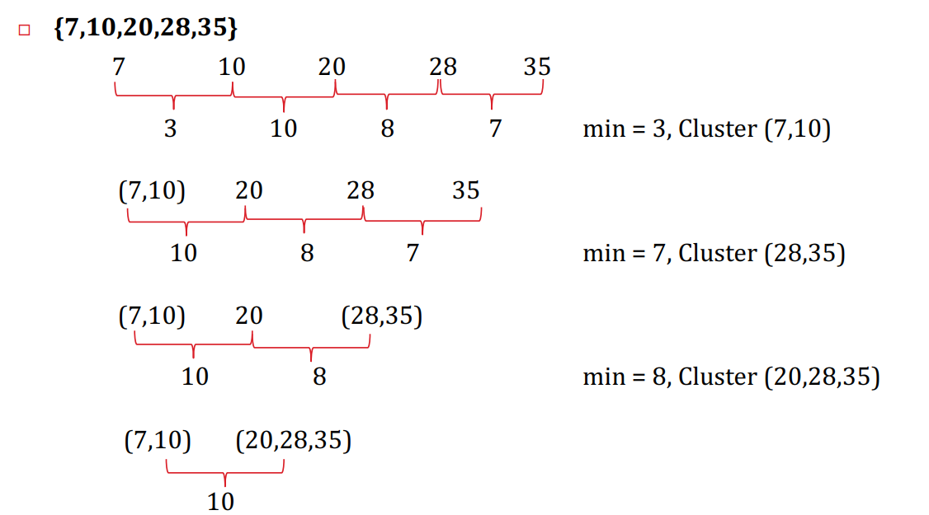
Example

Slide 35
Ward’s Clustering
Ward’s Clustering
Definition:
Ward’s method is a hierarchical clustering technique that aims to minimize the total within-cluster variance (or sum of squared differences) at each step of the clustering process.
Key Idea:
At each step, the two clusters that result in the smallest increase in total within-cluster variance after merging are combined.
This approach tends to create clusters of roughly equal size and is sensitive to outliers.
Algorithm Steps:
Start with each data point as its own cluster.
Compute the sum of squared deviations for all clusters.
Merge the pair of clusters whose combination minimizes the increase in total within-cluster variance.
Repeat steps 2–3 until all points are merged into a single cluster or until the desired number of clusters is obtained.

Slide 36
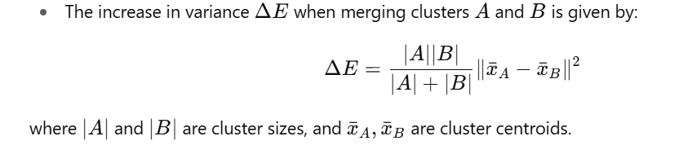
Ward’s Clustering
Distance Measure:
Ward’s method uses Euclidean distance as the common metric.
Advantages:
Produces clusters of similar size.
Works well with numerical data.
Reduces within-cluster variance effectively.
Disadvantages:
Sensitive to outliers.
Computationally expensive for large datasets.

Slide 37
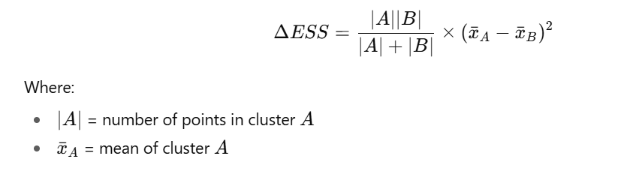
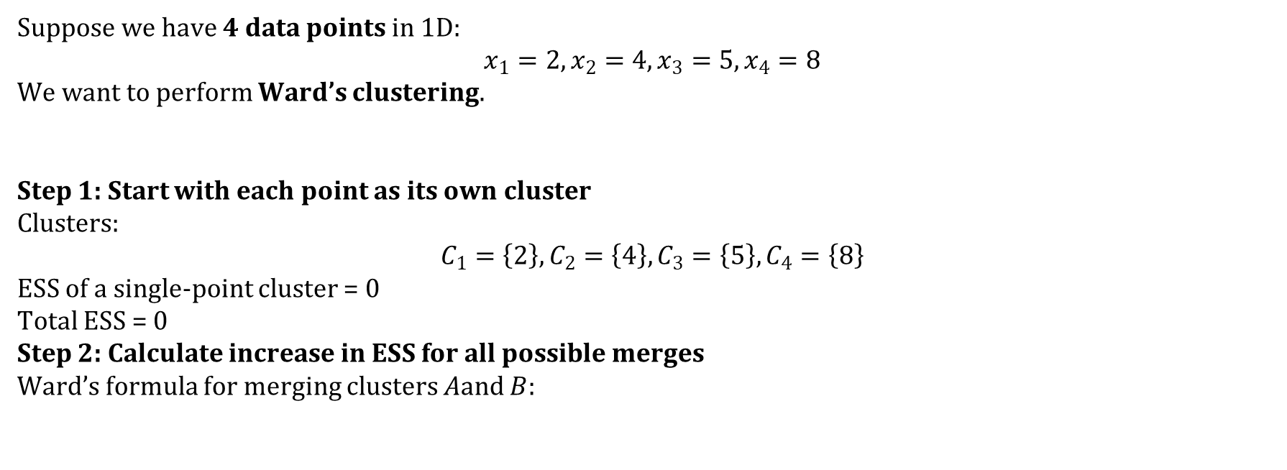
Numerical Example
Suppose we have 4 data points in 1D:
$$x_{1}=2, x_{2}=4, x_{3}=5, x_{4}=8$$
We want to perform Ward’s clustering.
Step 1: Start with each point as its own cluster
Clusters:
$$C_{1}=\left\{2\right\},C_{2}=\left\{4\right\},C_{3}=\left\{5\right\},C_{4}=\left\{8\right\}$$
ESS of a single-point cluster = 0
Total ESS = 0
Step 2: Calculate increase in ESS for all possible merges
Ward’s formula for merging clusters $A$and $B$:

Slide 38
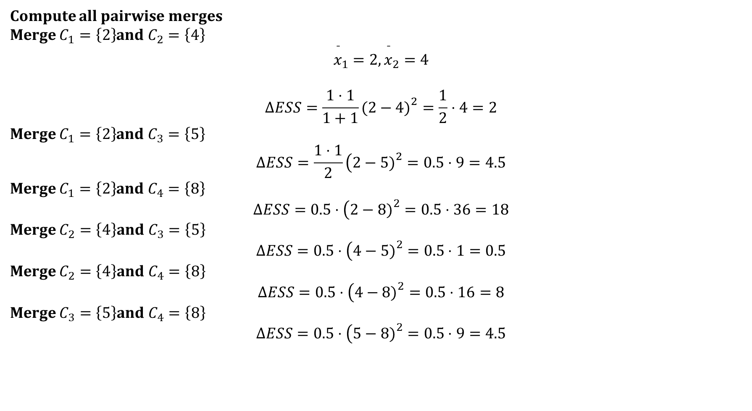
Compute all pairwise merges
Merge $C_{1}=\left\{2\right\}$and $C_{2}=\left\{4\right\}$
$${\overset{ˉ}{x}}_{1}=2,{\overset{ˉ}{x}}_{2}=4$$
$$ΔESS=\frac{1⋅1}{1+1}(2−4{\left.)\right.}^{2}=\frac{1}{2}⋅4=2$$
Merge $C_{1}=\left\{2\right\}$and $C_{3}=\left\{5\right\}$
$$ΔESS=\frac{1⋅1}{2}\left(2−5{\left.)\right.}^{2}=0.5⋅9=4.5\right.$$
Merge $C_{1}=\left\{2\right\}$and $C_{4}=\left\{8\right\}$
$$ΔESS=0.5⋅\left(2−8{\left.)\right.}^{2}=0.5⋅36=18\right.$$
Merge $C_{2}=\left\{4\right\}$and $C_{3}=\left\{5\right\}$
$$ΔESS=0.5⋅\left(4−5{\left.)\right.}^{2}=0.5⋅1=0.5\right.$$
Merge $C_{2}=\left\{4\right\}$and $C_{4}=\left\{8\right\}$
$$ΔESS=0.5⋅\left(4−8{\left.)\right.}^{2}=0.5⋅16=8\right.$$
Merge $C_{3}=\left\{5\right\}$and $C_{4}=\left\{8\right\}$
$$ΔESS=0.5⋅\left(5−8{\left.)\right.}^{2}=0.5⋅9=4.5\right.$$

Slide 39
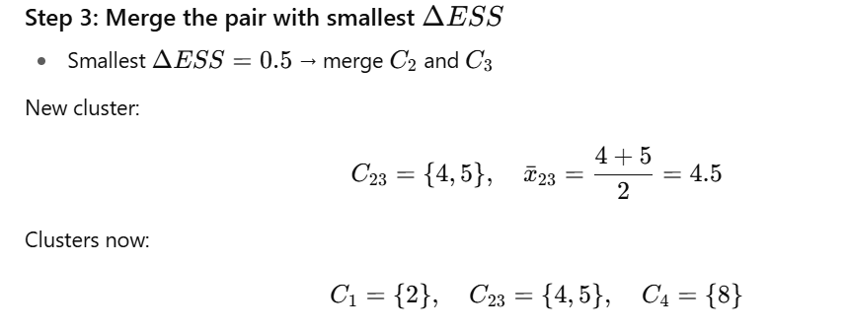


Slide 40



Merge order:
4 & 5 → $ΔESS=0.5$
2 & (4,5) → $ΔESS=4.167$
(2,4,5) & 8 → $ΔESS=14.083$

Slide 41
Minimum Spanning Tree (MST) Clustering
Definition:
MST clustering is a graph-based clustering technique that constructs a minimum spanning tree of a dataset and then partitions it by removing edges with the largest weights, forming natural clusters.
Key Idea:
Treat each data point as a node in a graph.
Edge weights are defined by the distance between points (e.g., Euclidean distance).
Build a Minimum Spanning Tree (MST) connecting all points with minimal total edge weight.
Remove edges that are significantly longer than others to separate clusters.
Algorithm Steps:
Represent data points as vertices in a graph.
Compute pairwise distances between all points.
Build the MST using Prim’s or Kruskal’s algorithm.
Remove edges with the largest weights (usually based on a threshold or desired number of clusters).
Remaining connected components represent clusters.

Slide 42
Minimum Spanning Tree (MST) Clustering
Advantages:
Can detect clusters of arbitrary shapes (not limited to spherical clusters).
Handles outliers naturally.
No need to specify the number of clusters upfront (threshold-based).
Disadvantages:
Sensitive to noise in the data.
Computationally expensive for very large datasets (requires O(E log V) for MST construction).
Applications:
Spatial data analysis.
Image segmentation.
Network clustering.

Slide 43

Expectation-Maximisation
The Expectation-Maximization (EM) algorithm is a powerful iterative optimization technique used to estimate unknown parameters in probabilistic models, particularly when the data is incomplete, noisy or contains hidden (latent) variables. It works in two steps:
E-step (Expectation Step): Using the current parameter estimates, the algorithm calculates the expected values of the missing or hidden variables. Essentially, it assigns probabilities or "responsibilities" to different hidden outcomes given the observed data.
M-step (Maximization Step): With these updated expectations from the E-step, the algorithm then re-estimates the model parameters by maximizing the expected log-likelihood. This improves how well the model explains the observed data.
These two steps are repeated until convergence, which typically means that:
The parameter values stop changing significantly, or
The log-likelihood improves only by a negligible amount.

Slide 44
Key Terms in Expectation-Maximization (EM) Algorithm
Lets understand about some of the most commonly used key terms in the Expectation-Maximization (EM) Algorithm:
Latent Variables: Variables that are not directly observed but are inferred from the data. They represent hidden structure (e.g., cluster assignments in Gaussian Mixture Models).
Likelihood: The probability of the observed data given a set of model parameters. EM aims to find parameter values that maximize this likelihood.
Log-Likelihood: The natural logarithm of the likelihood function. It simplifies calculations (turning products into sums) and is numerically more stable when dealing with very small probabilities.

Slide 45
Maximum Likelihood Estimation (MLE): A statistical approach to estimating parameters by choosing the values that maximize the likelihood of observing the given data. EM extends MLE to cases with hidden or missing variables.
Posterior Probability: In Bayesian inference, this represents the probability of parameters (or latent variables) given the observed data and prior knowledge. In EM, posterior probabilities are used in the E-step to estimate the "responsibility" of each hidden variable.
Convergence: The stopping criterion for the iterative process. EM is said to converge when updates to parameters or improvements in log-likelihood become negligibly small, meaning the algorithm has reached a stable solution.

Slide 46

Working of Expectation-Maximization (EM) Algorithm
Here's a step-by-step breakdown of the process:

Slide 47
Initialization:
The algorithm starts with initial parameter values and assumes the observed data comes from a specific model.
2. E-Step (Expectation Step):
Find the missing or hidden data based on the current parameters.
Calculate the posterior probability of each latent variable based on the observed data.
Compute the log-likelihood of the observed data using the current parameter estimates.
3. M-Step (Maximization Step):
Update the model parameters by maximize the log-likelihood.
The better the model the higher this value.
4. Convergence:
Check if the model parameters are stable and converging.
If the changes in log-likelihood or parameters are below a set threshold, stop. If not repeat the E-step and M-step until convergence is reached

Slide 48


Slide 49


Slide 50


Slide 51


Slide 52



Slide 53


Slide 54


Slide 55
Gaussian Mixture Models (GMM) for Probabilistic Clustering
Clustering is a popular technique in machine learning used to group similar data points together. One of the widely used clustering algorithms is Gaussian Mixture Models (GMM), which allows probabilistic clustering of data points.
GMM assumes that the data points are generated from a mixture of multivariate Gaussian distributions. In other words, each data point belongs to one of the Gaussian distributions, and the goal of GMM is to determine the parameters of these distributions and assign each data point to its most probable cluster.

Slide 56
How does GMM work?
The underlying idea behind GMM is that instead of hard clustering, where each data point is assigned to exactly one cluster, GMM provides a soft clustering approach. Soft clustering means that for each data point, we assign probabilities for it belonging to each cluster.
GMM starts by randomly initializing the parameters of the Gaussian distributions, including their means and covariance matrices. Then, in an iterative process called the Expectation-Maximization (EM) algorithm, GMM optimizes these parameters to maximize the likelihood of the observed data.
During the expectation step (E-step), GMM computes the probability of each data point belonging to each cluster based on the current parameter estimates. This step calculates the responsibility of each cluster for each data point.
In the maximization step (M-step), GMM updates the parameters of the Gaussian distributions based on the computed responsibilities. The parameters are re-estimated using the weighted mean and covariance of the data points assigned to each cluster.
This process of alternating between the E-step and M-step continues until convergence, where the algorithm reaches a stable solution.

Slide 57
Advantages of GMM for Probabilistic Clustering
Flexibility: GMM assumes that the data points are generated from a mixture of Gaussian distributions, which allows for modeling complex data distributions. This flexibility makes GMM suitable for a wide range of applications.
Soft Clustering: Unlike some other clustering algorithms, GMM provides soft clustering outputs. The probabilities of data points belonging to each cluster allow for a more nuanced representation of the data structure. This is especially useful when the data points are not clearly separable into distinct clusters.
Uncertainty Estimation: GMM provides a measure of uncertainty for each assignment. In addition to the most probable cluster assignment, the probabilities offer an insight into the confidence of the assignment. This is beneficial for tasks where decision-making relies on a level of confidence.
Effective on Large Datasets: GMM can handle large datasets efficiently, thanks to the EM algorithm. By iteratively updating the parameters, GMM converges to a solution without requiring the entire dataset to be loaded into memory simultaneously.

Slide 58
Applications of GMM for Probabilistic Clustering
GMM can be applied in various fields where probabilistic clustering is desired. Some common fields where GMM has been successfully used include:
Image Segmentation: GMM can be used to segment images by clustering pixels based on their color or texture features. The soft clustering output can provide smoother boundaries between different regions of an image.
Anomaly Detection: GMM can be used to model normal behavior in a dataset and identify anomalies as data points with low probabilities of belonging to any cluster. This technique is commonly used for fraud detection or outlier detection.
Text Mining: GMM can be applied to text data to cluster similar documents or identify topics within a collection. The soft clustering probabilities can be used for document classification or sentiment analysis.
Market Segmentation: GMM can group customers based on their purchasing behavior or demographic information, enabling companies to target specific customer segments for personalized marketing strategies.

Slide 59

DBSCAN

Slide 60


Slide 61


Slide 62


Slide 63


Slide 64

Evaluation

Slide 65


Slide 66



Slide 67


Slide 68

Small Cluster Preservation: This criterion emphasizes that splitting small categories into multiple clusters should be penalized more severely than splitting larger categories. Maintaining the integrity of smaller categories helps in identifying them more effectively.
Summary
• Cluster Homogeneity favors clusters with objects from a single category.
• Cluster Completeness ensures all objects of the same category are in one cluster.
• Rag Bag Criterion discourages mixing noise with pure clusters.
• Small Cluster Preservation prefers intact small categories over fragmentation.

Slide 69

Intrinsic Methods
Intrinsic Methods When the ground truth of a dataset is not available, we have to use an intrinsic method to assess the clustering quality. In general, intrinsic methods evaluate a clustering by examining how well the clusters are separated and how compact the clusters are. Many intrinsic methods have the advantage of a similarity metric between objects in the dataset.
The silhouette coefficient is a common intrinsic measure. It evaluates the quality of a clustering by calculating two distances for each object:
A silhouette coefficient close to +1 indicates that the object is well clustered and far from other clusters.
• A coefficient near 0 indicates that the object is on or very close to the decision boundary between two neighboring clusters.
• A negative value indicates that the object might have been assigned to the wrong cluster.

Slide 70


Extreme Value Analysis
Outliers

Slide 71


Slide 72


Slide 73


Slide 74
Distance Based outlier detection
A distance-based outlier detection method consults the neighborhood of an object, which is defined by a given radius. An object is then considered an outlier if its neighborhood does not have enough other points. This is termed as Distance-Based Outlier Detection Methods.
Distance-Based Methods usually depend on a Multi-dimensional Index, Which is used to retrieve the neighborhood of each object to see if it contains sufficient points. If there are insufficient points, then the object is termed an outlier.
Distance-Based methods scale better to multi-dimensional space and can be computed more efficiently than the statistical-based method. Identifying Distance-based outliers is an important and useful data mining activity. The main disadvantage of distance-based methods is that distance-based outlier detection is based on a single value of a custom parameter. This can cause significant problems if the dataset contains both dense and sparse regions.

Slide 75
Outlier detection methods can be categorized according to whether the sample of data for analysis is given with expert-provided labels that can be used to build an outlier detection model. In this case, the detection methods are supervised, semi-supervised, or unsupervised. Alternatively, outlier detection methods may be organized according to their assumptions regarding normal objects versus outliers. This categorization includes statistical methods, proximity-based methods, and clustering-based methods.
Algorithms For Mining Distance-Based Outliers:
Below are some algorithms which are used for Mining Distance-Based Outlier more efficiently.
Index-based algorithm: The index-based algorithm facilitates multidimensional indexing structures, including R-trees or k-d trees, to search for neighbors of each object o inside radius d around that object. Once K (K = N(1-p)) neighbors of object o are discovered, it is accessible that o is not an outlier. This algorithm has the lowest case complexity of O (k * n²), where k is the dimensionality, and n is the number of objects in the data set.
Nested-loop algorithm: The nested loop algorithm has the same evaluation complexity as the index-based algorithm but avoids building index structures and minimizes the amount of I/O. It splits the memory buffer in half and puts the data into several logical blocks.
Cell-based algorithm: It avoids the O(n²) computational complexity and develops a cell-based algorithm for memory-resident datasets. Its complexity is O(c*k + n), where c is a constant based on the number of cells and k is the dimension.

Slide 76

Density Based Outlier detection
Aim: Spot “odd one out” points not simply by distance but by relative isolation
Motivation: In datasets with varying densities, pure distance-based methods fail
A point that’s “far” in a dense region might be “normal” in a sparse region
LOF-Local Outlier Factor compares local densities rather than absolute distance
Why Not Just Distance?
Distance-based methods (e.g. KNN outlier) classify points far from neighbors as outliers
The flaw: data may have clusters with different densities
LOF: shifts perspective — is a point “isolated relative to its neighbors”?

Slide 77

LOF Workflow
Standardize data — ensure features are comparable
Choose k, the number of neighbors
Compute distances to find each point’s k-nearest neighbors
Compute reachability distance
Compute local reachability density (LRD)Compute LOF score
Reachability Distance

Slide 78

Local Reachability Density (LRD)

Slide 79

LOF Score

Slide 80
Strength and Use cases:
Relative detection: finds outliers in locally sparse regions even if not far globally
Good in real-world, messy datasets with non-uniform densities
More nuanced than pure distance threshold methods
Limitations & Hyperparameters
Sensitive to choice of k
Too small → too sensitive to noise
Too large → smooths out local peculiarities
Computational cost: needs distance computations and neighbor sets
Works best in moderate dimensions; with very high dimensions distance metrics degrade
Local Outlier Factor (LOF) Explained | by Dinusha Dissanayake | Data Science Collective | Medium

